Slide 1
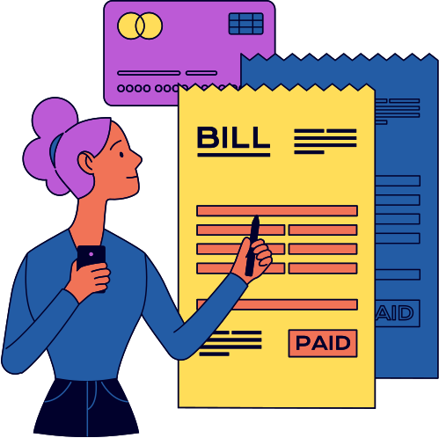
Let's cut to the chase...
This is about
ANALYZING NITIN'S EXPENSES: A PATH TO FINANCIAL WELLNESS"
Aatif Patel

Slide 2
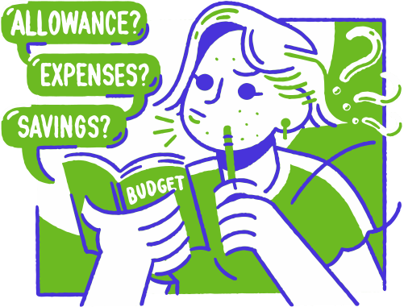
Problem Statement:
Nitin is facing financial challenges due to:
•High expenses: His spending exceeds his income.
•Lack of financial awareness: He may not understand his spending patterns.
•Limited financial literacy: He needs guidance on budgeting and saving.
02/10

Slide 3


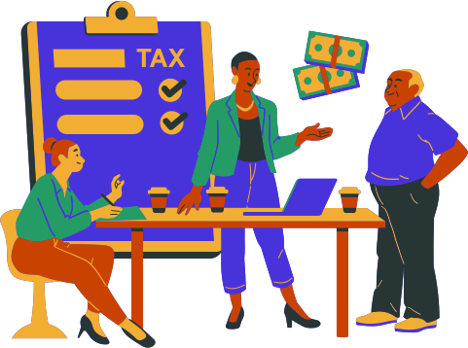
By this we aim to:
ACHIEVE HIS LONG-TERM FINANCIAL GOALS.
REDUCE UNNECESSARY EXPENSES.
INCREASE HIS SAVINGS RATE.
09/10

Slide 4





Tasks to carry out in this Project
1. Different items of each category
2. Spent for each category
3. Money spent different items EC

Slide 5
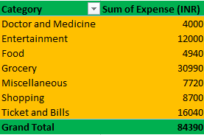
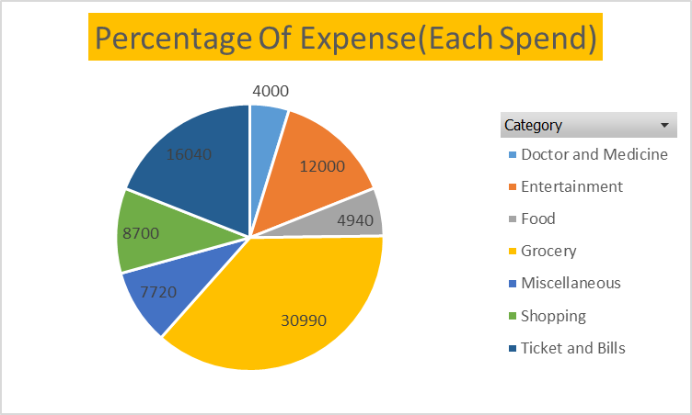
Part 1 Task 1 :-
How much is spent for each category
Part 1 Task 1 :-
Visually represent amount spent against each category is what percentage of the total expense amount
07/10

Slide 6
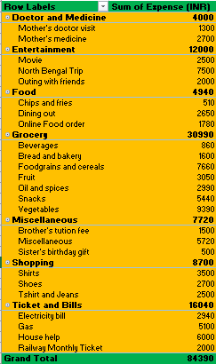
Part 1 Task 2 :-
How much is spent on different items of each category

Slide 7
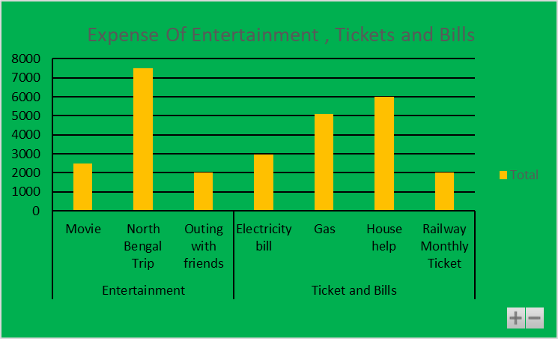
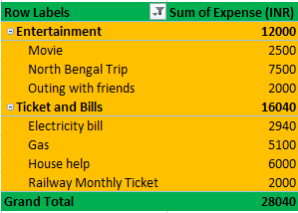
Part 1 Task 2 :-
Visually represent the amount spent on different items of Entertainment and tickets and bills category
07/10

Slide 8
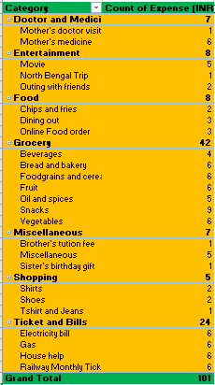
Part 1 Task 3 :-
How many times money has been spent against different items of each category

Slide 9
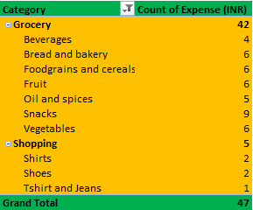
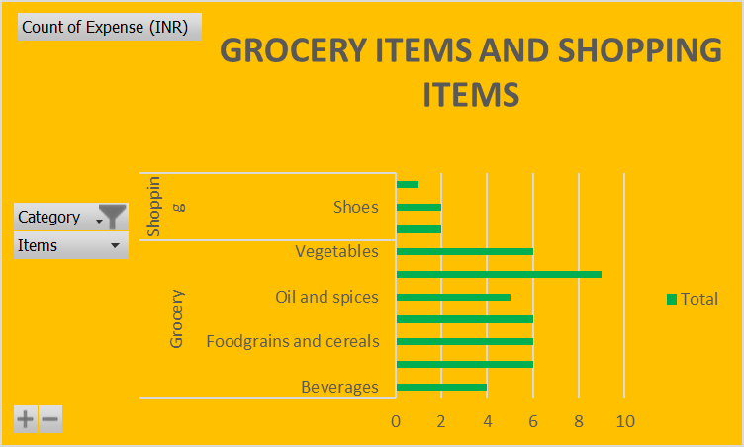
Part 1 Task 3 :-
Filter the data to display the data for Grocery items and shopping items
07/10

Slide 10
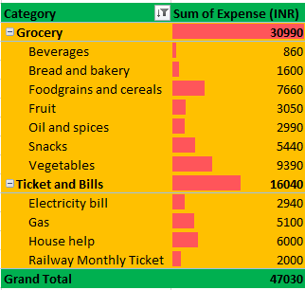
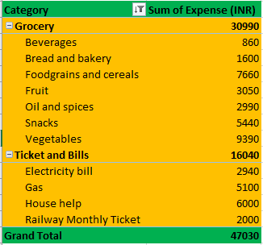
Part 1 Task 4 :-
What amount is spent on each item of the categories with highest and 2nd highest expense amount
Part 1 Task 4 :-
Visually represent the data with data bars
07/10

Slide 11
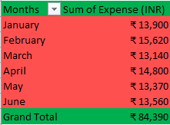
Part 2 Task 1 :-
Month wise trend of expenses
07/10

Slide 12

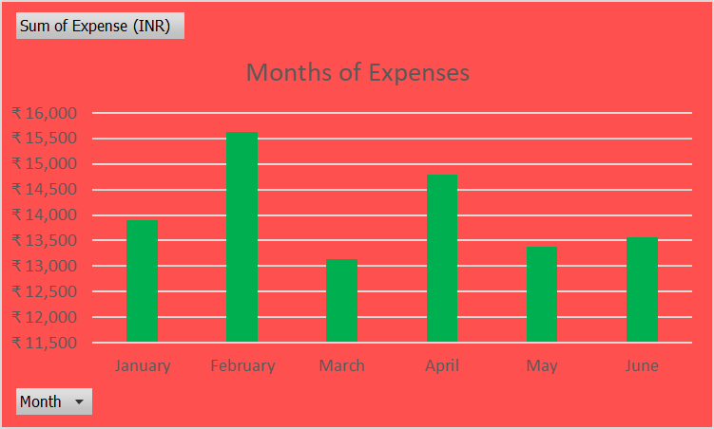
Part 2 Task 1
Visually represent the month Nithin spent the most
07/10

Slide 13
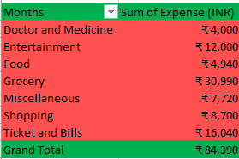
Part 2 Task 2 :-
Category wise expenses
07/10

Slide 14
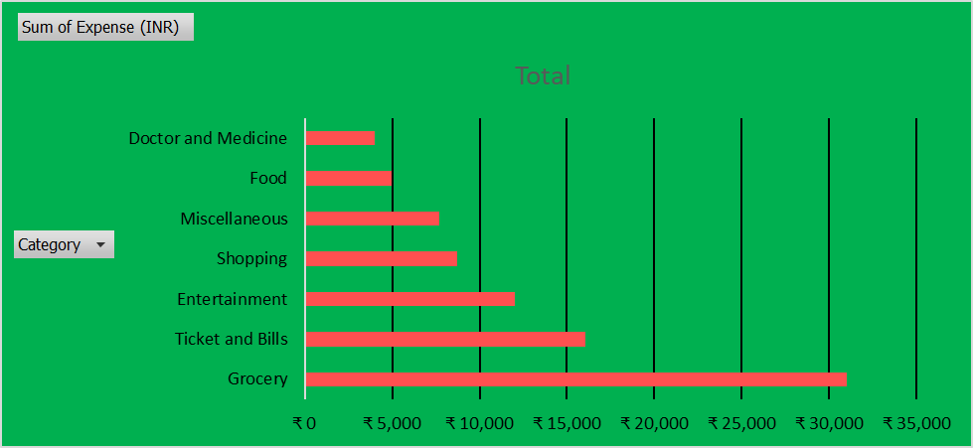
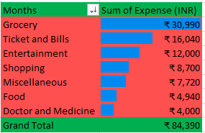
Part 2 Task 2 :-
visual representation of data bars to display categories with the highest and lowest expense amount.
07/10

Slide 15
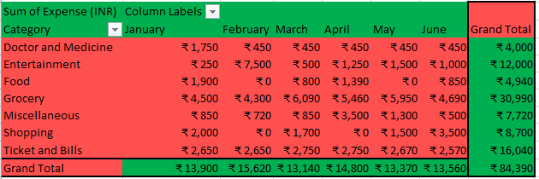
Part 2 Task 3 :-
Month wise expense of each category
07/10

Slide 16
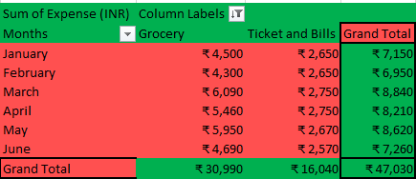
Part 2 Task 3 :-
Find out 2 categories with higher expenses for each of the 6 months.
07/10

Slide 17
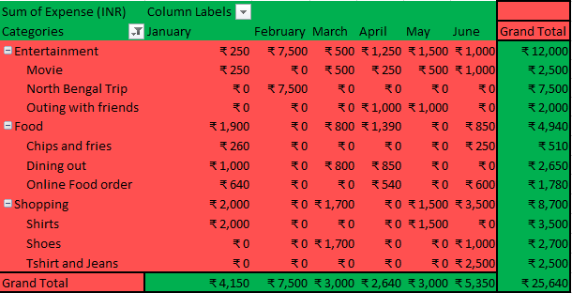
Part 2 Task 4 :-
How much is spent in each month against different items of Entertainment,Food and Shopping categories(pivot table).
07/10

Slide 18
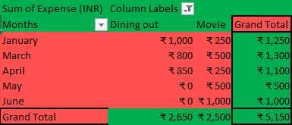
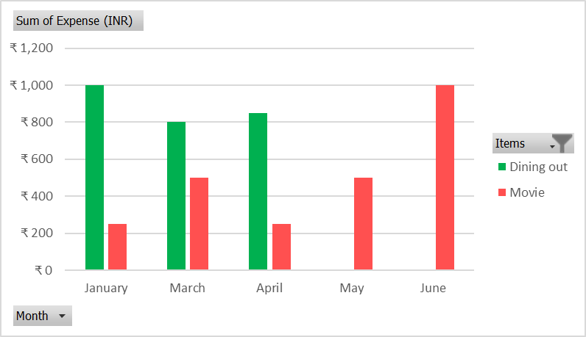
Part 2 Task 4 :-
Find out which months have the highest amount spent for movies and dining out.
07/10

Slide 19
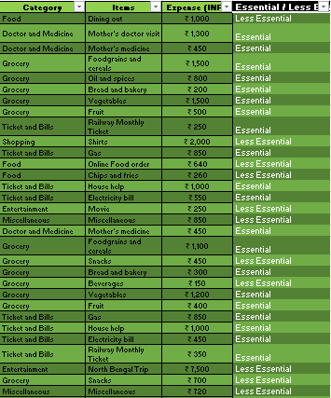
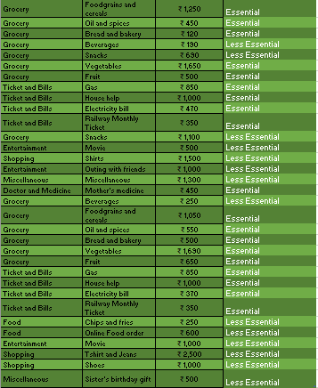
Part 2 Task 5 :-
Decide on the essential and less essential items and analyse the expenses.
07/10

Slide 20
Conclusion : -
Recommendation for nitin for increasing his savings with reasons.
1
Prioritize High-Impact Areas:
Implement the 50/30/20 Rule:
Allocate 50% of income to essentials, 30% to discretionary spending, and 20% to savings/debt repayment.
Analyze spending and focus on major categories like housing, transportation, and food
2

Slide 21
Conclusion : -
Recommendation for nitin for increasing his savings with reasons.
4
Negotiate & Reassess Subscriptions:
•Explore Side Hustles:
•Monetize skills or hobbies, consider part-time work or freelancing.
Cancel unnecessary services or negotiate better rates. Explore cheaper alternatives.
3

Slide 22
Conclusion : -
Recommendation for nitin for increasing his savings with reasons.
5
7
Adopt a Frugal Mindset:
Seek Professional Advice:
Automate Savings:
Set automatic transfers to savings, and utilize employer benefits for retirement.
Practice mindful spending, avoid impulse buys, and cook at home more.
Consult a financial advisor or credit counselor if needed.
6

